Slide 1
Getting Ready for Give Big Green Bay
Feb 19-20, 2025
Notes:
🗣️ Presenting Tips: Have water available, take a deep breath, and don’t be afraid to speak slowly and take pauses when you need to. You’ve got this! 🤩
⚠️ Make sure you are recording! ⚠️
💡 Use the “Find and replace” feature on Google Slides to update the “snippets” for this presentation. Below are the list of “snippets” you can replace with specific information for your giving day. 💡
[DoG]
[DoG Name] (same as DoG)
[DoG URL]
[Partner Organization]
[Year]
Presenter Notes:
Welcome attendees
If starting right at start time, feel free to wait up to 2 additional minutes to allow for additional attendees to join
Presenter Script:
Hello everyone and welcome! I’m so glad that you all are joining today’s webinar on Getting Ready for [DoG]. We’re going to wait a couple of extra minutes to allow folks to sign on, and get started at –:02.

Slide 2
Submit Your Questions
Chat Box
Q&A
If you have questions or comments throughout our training, please write in using your Zoom webinar attendee panel.
Notes:
Presenter Script:
Just a few housekeeping notes before we jump into today’s presentation. This webinar is being recorded so you’ll be able to revisit the presentation at your convenience, or share it with someone who wasn’t able to attend today.
You are all on mute in order to keep the noise levels to a minimum - however we do encourage questions, so please take a moment to locate your Q&A box now and we’ll save time at the end to address all of your questions.
As a friendly reminder, please be sure to submit any questions that you have through the Q&A box rather than chat. This will help us ensure that your questions don’t get missed.
With that said, please take some time to write into the chat now and let us know what organization you’re representing today, as well as whether you’re a [DoG] veteran or if this is your first time participating.

Slide 3
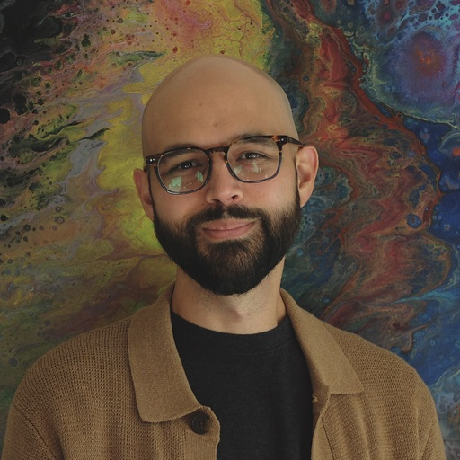
Meet the Team
Claire Ripley
Onboarding Consultant
Cameron Navarro
Onboarding Consultant
Notes:
🖌️ Design Note: Scale circles and corresponding text depending on how many team members are on page
**To add headshot, click on photo and use Crop tool to select circle shape.
Presenter Notes:
Welcome attendees again
Introduce self
Introduce co-host (backup PM or CS Champ) and partners that may be on the line
Some partners like to greet attendees at this point so discuss that ahead of time with your partner
Presenter Script:
Hello again and welcome to our webinar on Getting Ready forGive Big Green Bay 2025. I’m so glad you all could join us today as we dive into the details!
I know you had the opportunity to meet with the Green Bay team already for helpful setup, but I am excited to jump in and provide any information I can as well.
My name is Claire, and I am the Onboarding Consultant for Give Big Green Bay,
I am also joined by Cameron, who is also an Onboarding Consultant here at Bonterra, and they will be helping to monitor our chat and Q&A throughout our presentation.

Slide 4
Agenda
Give Big Green Bay Overview
Who is Bonterra?
What’s New
Registering
Creating Your Profile
P2P Help
Next Steps & Questions
Notes:
🖌️ Design Note: Keep titles short and to the point. Leave extra information for when you present
Presenter Notes:
Quick overview of the agenda
Presenter Script:
So with that, let’s jump right in!
Here’s a quick summary of what we’re covering in today’s presentation.
We’ll be going over everything from the basics of [DoG], to how to register and set up your profile, and end with a quick checklist of your next steps and Q&A.
There is a ton of great information in this presentation, so just a friendly reminder that the slides and recording will be available online later today [or tomorrow] for review.

Slide 5
2024 Results
Notes:
Presenter Notes:
Call attention to last year’s results
Express excitement to have another great year
Presenter Script:
Before diving into this year’s presentation, I wanted to take a moment to acknowledge the awesome results from last year.
X dollars were raised by X donors for X organizations.
(Feel free to elaborate on additional results, or share goals for 2022 with partner’s approval.)

Slide 6
GBGB Overview
www.givebiggreenbay.org l Feb 19 12PM
Every nonprofit conducts their own unique campaign to market and share with their supporters
Your marketing efforts + The Greater Green Bay Community Foundation Efforts = Exponential visibility
Leaderboards for friendly competition, prize incentives
Central Routing—no need to be bank account verified!
Donations open on Feb 19 12PM
Notes:
Presenter Script:
I’ll start with the basics -
GBGB is going to be Feb 19 at noon to the following day, feb 20 at noon!
For GBGB, each nonprofit organization will conduct their own unique campaign to market and share with their supporters. All participating nonprofits will need to complete their profile for the Giving Day And don’t worry - I’ll go over that shortly!
Participants will receive exponential visibility generated by their own marketing efforts to spread awareness about the day, as well as the efforts of The Greater Green Bay Community Foundation. By being a part of the momentum of GBGB and leveraging the tools available to you through your participation, your organization has the potential to reach a brand new audience of supporters.
In order to participate, organizations must be an IRS recognized tax-deductible nonprofit, and in compliance with state solicitation requirements.
An exciting benefit to participating is the opportunity to participate in friendly competition via leaderboards and to win prizes throughout the day.
Additionally, your host organization has chosen to be centrally routed, which means they have saved you the trouble of manually entering your bank account information to help streamline your getting ready process.

Slide 7
Benefits of Participating
Learn to utilize digital fundraising tools, and take advantage of resources that are available year-round!
Re-Engage with your existing supporters and gain new donors
Combine your marketing efforts + Greater Green Bay Community Foundation marketing = exponential visibility for all organizations
Utilize the Giving Day to reach other internal goals
Motivate donors to make a greater impact with prizes and match incentives
Notes:
Presenter Script:
So what are the additional benefits that your organization will receive as a result of participating?
Well, your organization has the opportunity to learn how to utilize new digital fundraising tools, and take advantage of the fundraising resources that are available year-round on the site. Bonterra and Greater Green Bay Community Foundation provide numerous resources on general fundraising geared specifically towards GBGB but that can be accessed and used year-round to provide inspiration and best practices for fundraising, engagement, and stewardship.
Participating provides the opportunity for your organization to re-engage and strengthen relationships with your existing supporters, as well as gain new donors and supporters. For example, GBGB can present an opportunity for volunteers to assist with marketing or P2P fundraising efforts, which allows those supporters to engage with your organization at a higher level.
By participating, you are capitalizing on the momentum of the giving day to get your organization in front of new audiences. Participating means that you are combining your marketing efforts with greater green bay community foundatin's marketing efforts, which will provide exponential visibility for all participating organizations.
The giving Day can also be used as a way to reach other internal goals that your organization has. We encourage all participating organizations to identify some goals that go beyond dollars raised that [DoG] can help to achieve. For example, you can use [DoG] to increase volunteer participation, increase social media followers, or enhance stewardship programs.
Additionally, because there are prize and match incentives on the day, this is an incredible motivator for donors. Donors will be incentivized to make a greater impact on the day knowing that their dollars go further thanks to sponsor matching and prize opportunities
[I’d love to hear in the chat from some organizations that utilized [DoG] to reach internal goals whether it be dollars raised, donors, or social media followers. Please feel free to write in now and share with others what goals [DoG] has helped your organization to achieve.]

Slide 8
Who is
Bonterra?
Notes:
Presenter Notes:
Now that I’ve covered the basics, I’d like to tell you a little more about Bonterra and who we are.

Slide 9
Who is Bonterra?
Bonterra’s mission is to power those who power social impact
Host a secure, reliable and transparent platform for Give Big Green Bay
Create the ultimate donor experience
Provide a dedicated support team
GiveGab is becoming Bonterra!
Notes:
Presenter Script:
Bonterra’s mission is to power those who power social impact.
As [DoG]’s technology partner, we provide the platform where you registered for the day and will complete your profile!. [For those of you that have participated in the past, you’re already familiar with the giving day dashboard where you manage all things Giving Day.] Each year, you will be able to log in and use the same account to manage your participation in [DoG]. We strive to make registering and completing your profile as easy and enjoyable as possible, and we’ll cover this process more in depth in just a little while!
Not only do we strive to make your experience of participating in [DoG] as seamless as possible, we’re also dedicated to providing the ultimate donor experience. In addition to providing a secure, reliable, and easy to use method of donating, all donors are automatically receipted immediately upon making their donation.
Here at Bonterra, we encourage you to think of us as an extension of your team. As such, we provide a dedicated support team to help you, [your P2P fundraisers,] and donors with any questions that you may have about the platform. In addition to providing email and chat support during regular business hours, we offer an extensive Help Center where you can easily find answers to your questions 24/7. No question is too big or small for our support team - if you have technical questions about registering, or simply want someone to offer feedback on filling out your profile, our team is here to help.
GiveGab is becoming Bonterra! If you see the name “GiveGab” anywhere, don’t worry, that’s us! This doesn’t change your participation in [DoG] or impact the tools we’re going to review in today’s webinar, and you’ll continue to receive the same customer love and support you always have!

Slide 10
Donation Security
Partnered with Stripe - PCI Level 1 Payment Processor for donation processing
Direct deposit funds within 5-7 business days
Your banking information is reviewed by Stripe
Donor credit card information is not revealed or saved in Bonterra
All participating organizations verified as IRS and state-recognized nonprofits
Notes:
\s
Presenter Script:
One of Bonterra’s top priorities is security and reliability.
To ensure this, Bonterra partners with Stripe, a PCI Level 1 Payment Processor for secure donation processing.
Donor payment information is never revealed or saved within Bonterra, but instead securely passed through to Stripe for processing.
When a donor gives to your organization, funds are deposited directly into your bank account within 5-7 business days. In order to become verified to receive donations, your organization must have a bank account that can accept ACH transfers. When setting up your direct deposit, your information will be securely passed through and verified by Stripe.
Additionally, Bonterra verifies that all participating organizations are verified as IRS and state-recognized nonprofits. By doing this, we ensure that donors can feel confident that they’re giving to who they think they are.

Slide 11
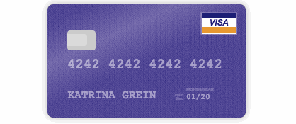
Simple Donation Processing
All major credit cards accepted
Log right into your bank to use the Plaid/ACH payment
Quick, easy and fun donation flow
Securely processed through Stripe
Chat support available right within the donation form for your supporters!
Notes:
Presenter Script:
Bonterra provides simple donation processing to ensure that the donor experience is easy and enjoyable.
All major credit cards accepted.
[Additionally, donors giving over $X amount can make their gift by logging directly into their online bank to take advantage of lower processing fees - but more on that later!]
When exploring [DoG URL], donors will have the option to add donations to their gift basket. This provides them an easy way to keep track of the organizations that they want to give to, while exploring additional organizations throughout the site. When it comes time to check out, they’ll have the option to easily view their gift basket and complete their donations.
We process all transactions securely using our payment processor, Stripe, which, as mentioned earlier, is a PCI Level 1 Compliant payment processor. This is the highest level of compliance available.
Although our donation process is simple, fun, and easy to use, we understand that questions can come up. We understand how important is to have support available during the critical moments of a donor actually making their gift. Because of this, we have chat support available right within the donation form for easy access to our support team every step of the way!

Slide 12
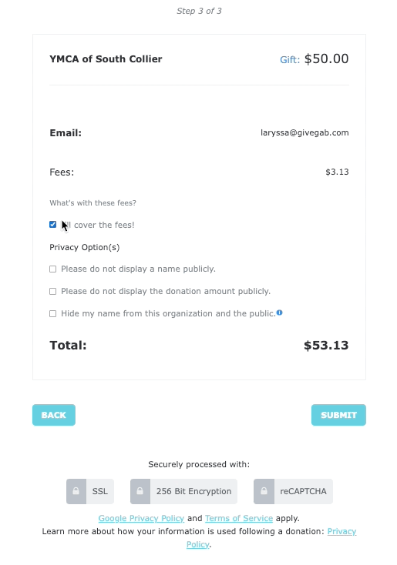
Transparent Donations
Credit Card, ACH, Mobile Pay, Paypal, Venmo for online transactions
Donors can cover all fees on behalf of your organization
Historically, donors cover 65-75% of fees during a Giving Day
Notes:
Presenter Script:
When donors give through Give Big Green Bay they will have the option to cover the donation processing fees in the last step of the donation form. While this is totally optional, we find that historically 65-70% of donors cover fees during a giving day. While this is totally optional, last year 87% of donors covered the fees when making their gift during Give Big Green Bay
This means that it only cost $1.30 per $100 raised online! Although there is always a cost to raising funds online, donors are not always aware of these costs. By providing transparency around fees, most donors are willing to cover them to ensure that their recipient organization receives 100% of their intended donation.

Slide 13
Transparent Donations
Credit Card:
3% Platform Fee
+
$0.30 per transaction & 2.5% transaction fee (Stripe)
=
5.5% + $0.30
ACH:
3% Platform Fee
+
$3.00 flat bank fee
=
3% + $3.00
*$100 minimum
Paypal Fees:
3% Platform Fee
1.99%+ $0.49
Notes:
Presenter Notes:
So what fees are associated with making a gift during [DoG]? Explain above fee structure.
Presenter Script:
So what fees are associated with making a gift on [DoG]?
When making a gift via Credit Card, the fees for making a gift on [DoG] are 3% platform fee + 2.5% + $0.30 transaction fee. This equals a total of 5.5% + $0.30 when making a donation via Credit Card.
For donations over $100, donors have the option to give via Credit Card or via direct ACH. This means that they’ll have the option to connect their online banking account to make a gift directly from there to [DoG]. The fees associated with this method are a 3% platform fee, plus a flat, $3 bank fee for a total of 3% + $3. Donors who are giving in larger amounts appreciate having this option to save on fees, and like we saw earlier, X% of donors have historically covered the fees bringing the cost of fundraising down to just $X per $100 raised online.

Slide 14
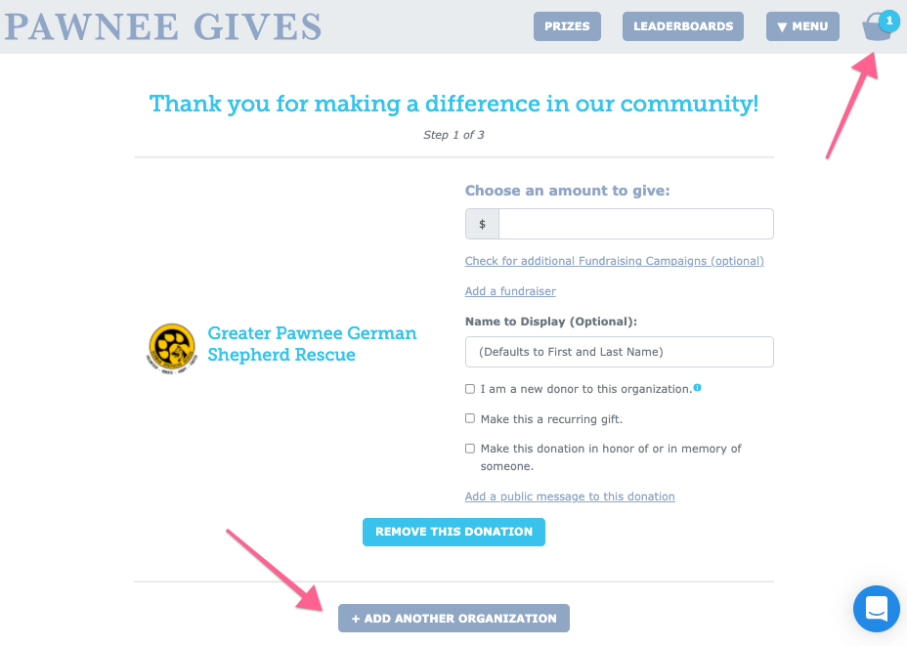
The Gift Basket makes it easy for donors to support as many causes as they like!
Notes:
Presenter Scripts:
On this slide, you can see an example of our awesome Gift Basket feature that I mentioned earlier
Donors can add organizations to their gift basket to keep track of where they’d like to give as they browse the site.
Donors can add organizations to their gift basket by selecting that option on each organization’s profile, OR by selecting “+ Add Another Organization” right within the donation form.
This makes it easy for donors to support multiple organizations in one smooth transaction!

Slide 15
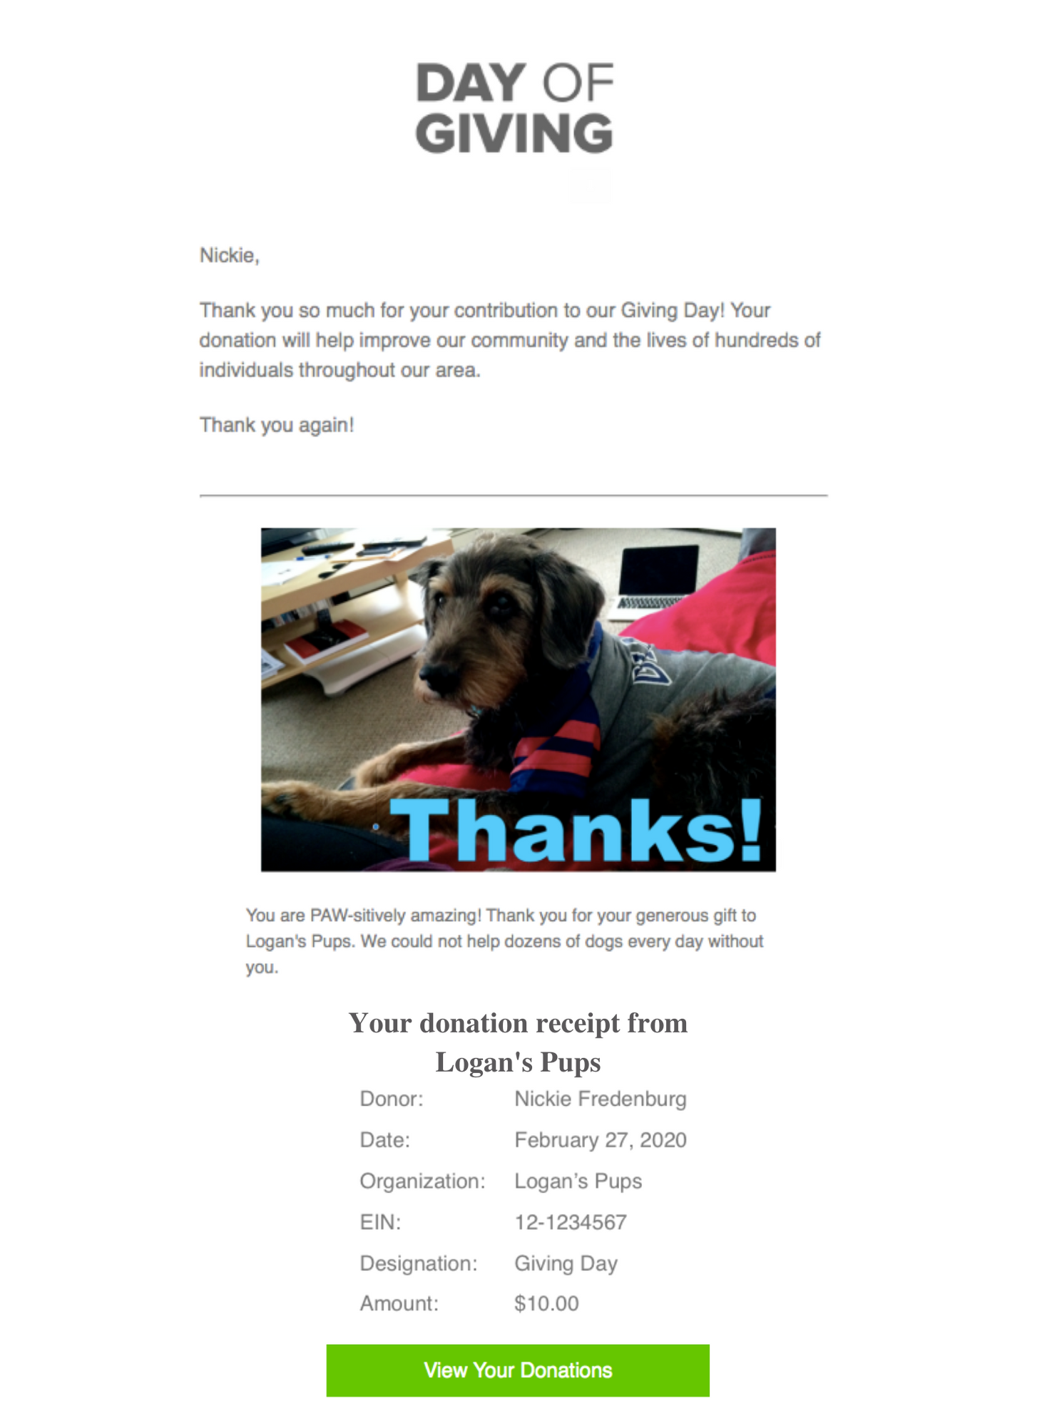
Instant Donor Delight
A Thank You email after making donation
Sent immediately after the gift is made
Includes donation amount to act as a tax-deductible receipt
Notes:
Presenter Script:
Once donors make their donation, they will immediately receive a thank you email from the Bonterra Giving Day platform.
This thank you letter can be customized to include a special message from your organization, and we’ll cover more details on how to personalize this a little bit later in today’s presentation!

Slide 16
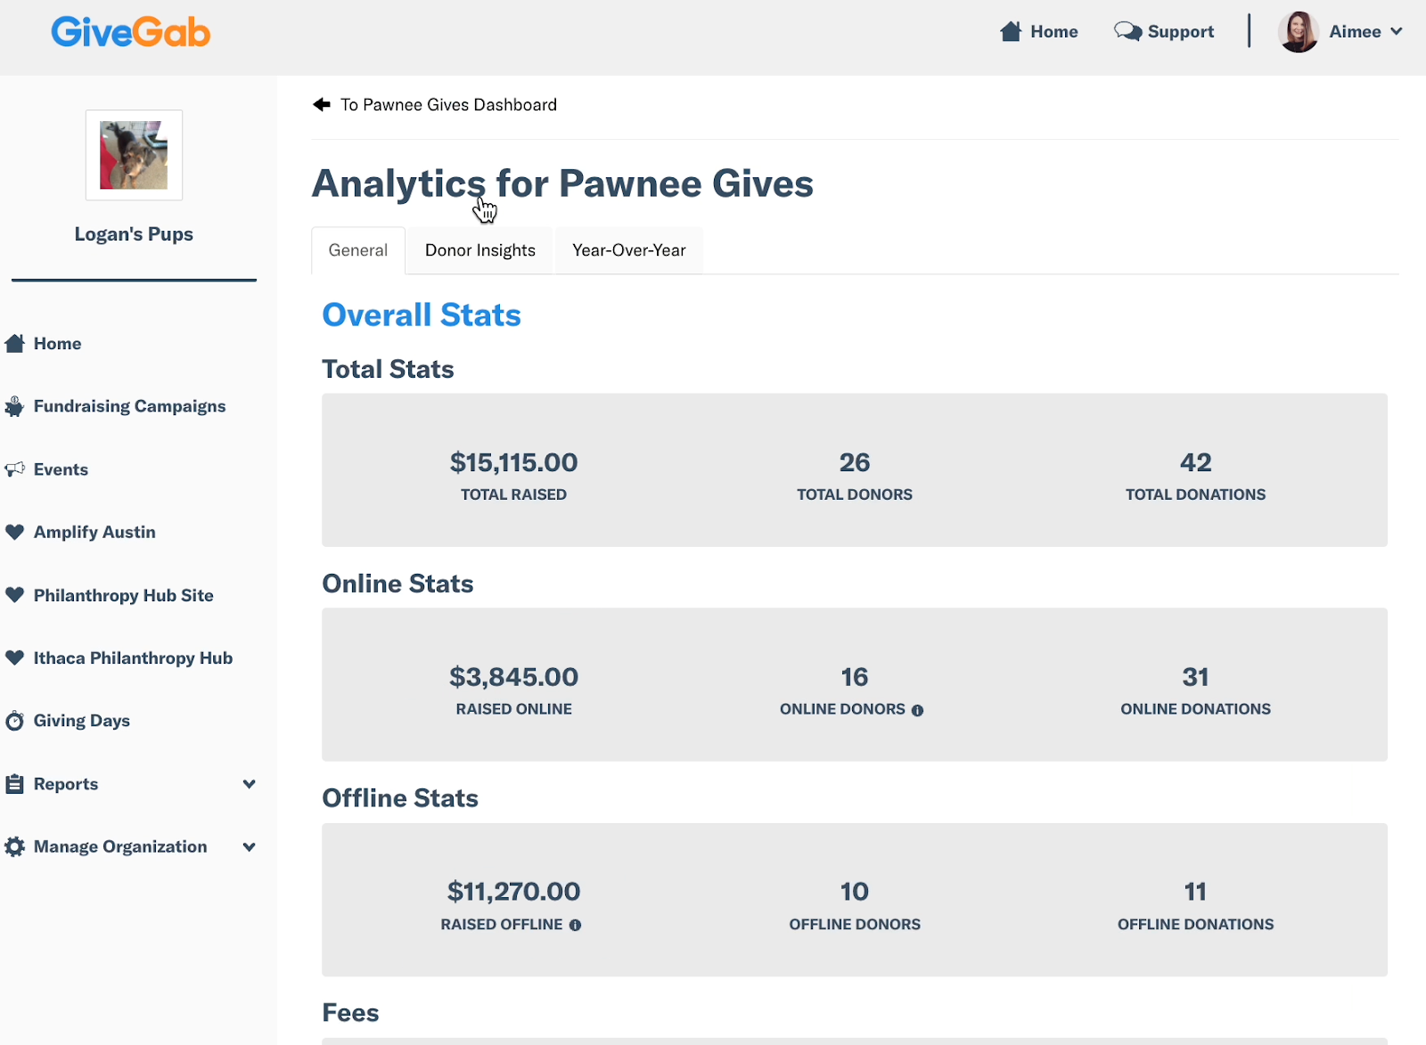
Giving Day Analytics
Key stats are available for the following data points:
Donor counts (online, offline, total)
Donation counts (online, offline, total)
Average donation size
Average donations per donor
New donors
Fee coverage
Year-Over-Year comparisons

Slide 17
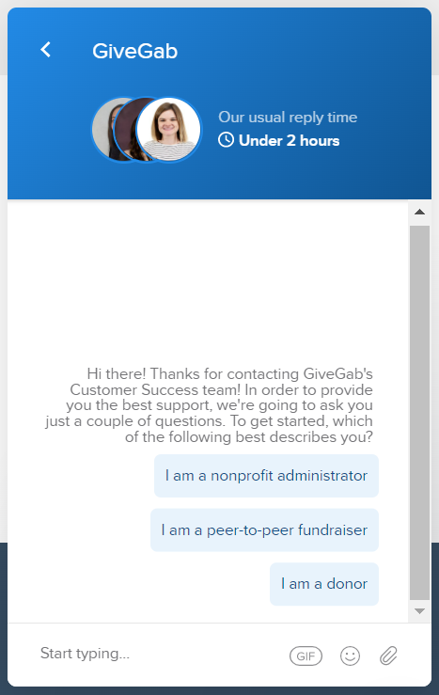
Giving Day
Support &
Resources
Visit our Help Center
Check out Our Blog
Chat with our Customer Success Team
Look for the little blue chat bubble
Notes:
Presenter Script:
We have a dedicated Customer Success team available to help answer any questions that may come up at any time throughout this process, in addition to hundreds of support articles that are available online 24/7.
We also have an extensive blog where you can find tips, tricks, and strategies to take your giving day to the next level.
To get in touch with our Customer Success team,simply write into the little blue chat bubble with your question.
Our team is here to help you succeed, so remember that no question is too big or small to ask.

Slide 18
Completing Your Profile
Notes:
Presenter Notes:
Now that we’ve walked through how to register for [DoG] [Year], we’ll walk you through each step to completing your profile to ensure it is giving day ready!

Slide 19
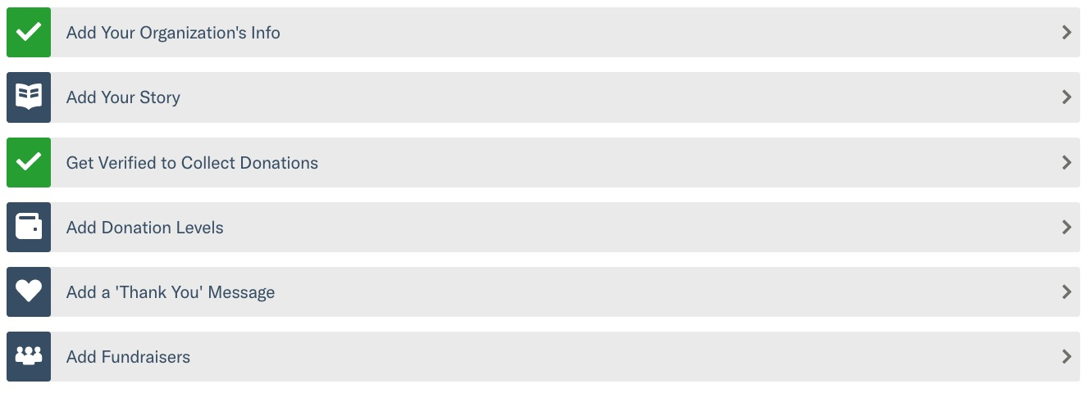
Your Giving Day Dashboard
Notes:
Presenter Notes:
Each blue box represents an area of your profile that has yet to be completed
Each green check mark represents an area of your profile that is already complete
Presenter Script:
Once you’ve completed registration, you’ll be taken to your Giving Day Dashboard. This will be your home base for managing your profile for [DoG].
Each blue box represents an area of your profile that has yet to be completed, and each green check mark represents an area of your profile that is complete.
In order to set your profile up for success, we recommend that you complete each section of your profile.
Over the next few minutes, we’ll cover each of these steps more in depth.

Slide 20
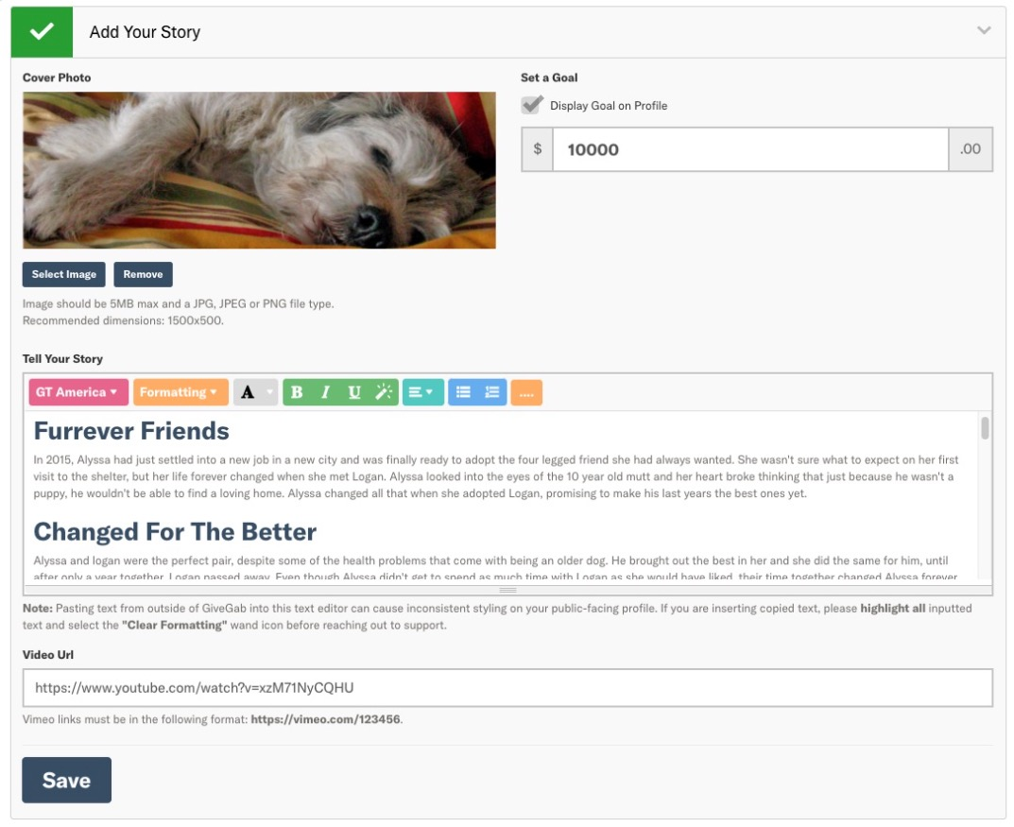
Curate Your Story
Add a cover photo
Set a monetary goal
Tell the story of your organization’s participation in the giving day through words and visuals
Notes:
Presenter Notes:
Add a cover photo
Set a monetary goal
Tell the story of your organization’s participation in the giving day through words and visuals
Use this as an opportunity to make an emotional appeal to your donors
Presenter Script:
Once you’ve filled out the basic information about your organization, you’ll move on to the next step on your Giving Day Dashboard which is to add your story.
In this section, you’ll be prompted to add a cover photo, set a monetary goal, and tell the story of why your organization is participating through both words and visuals.
I want to take a moment to stress the importance of adding a thoughtful story to your Giving Day profile. For donors that are not familiar with your organization yet, this will be their only opportunity to get to you know organization and why you’re raising funds. Testimonies, first-hand accounts from beneficiaries, or a letter from your President making a personal request for support, all are great examples of ways to make an emotional appear to your audience for their support.
In addition to using words to share your organization’s story, we encourage you to use photos and videos whenever applicable. If your organization cannot use photos of beneficiaries for privacy reasons, there are tons of free stock images available to help illustrate your story with visuals.

Slide 21
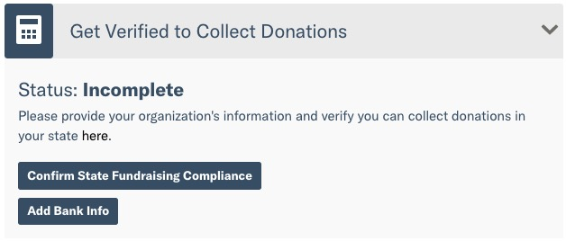
No Need to Verify Bank!
The Greater Green Bay Community Foundation has graciously offered "central routing" which means you don't have to worry about entering your bank account info in your profile! They will disperse the funds after the donations close
Notes:
Presenter Notes:
State Attestation Compliance
Basic information about your organization
Banking information for your organization
Organization Representative information
This is separate from your “application” process to participate
Pro Tip: Don’t wait to complete this information. It can take at least several days, and in some instances more
Presenter Script:
The next step on your Giving Day dashboard is one of the most important steps - getting verified to receive donations! Without completing this step, your organization will not be able to receive donations on your Giving Day.
There are a few different components to becoming verified which we’ll walk through now.
First, is state attestation compliance. In order to fundraise on the Bonterra Giving Days platform, your organization must attest to compliance with state charitable solicitation laws. More information about what this means for your organization can be found on your “Bank Account & Verification” page.
Next, you’ll be requested to provide some basic information about your organization, such as legal name, DBA name, and address, as well as banking information for where your donations should be deposited.
Additionally, you’ll be required to provide information for an organization representative. The organization representative for your organization should be someone who has both administrative access to your profile, as well as oversight of your organization’s bank account. Additional information about who the organization representative should be and what they will need to provide can be found in our Help Center.
For 2022: One thing we wanted to call attention to is that recently financial regulators have begun enforcing additional verification requirements. Payments regulations like these aim to create a safer, more secure financial ecosystem by helping prevent crimes like money laundering, fraud, and tax evasion. For organizations that have participated in the past, please keep an eye out for a communication from our Process Coordinator with instructions on how to provide this additional information. When providing this information, you will be doing so directly through the secure Stripe portal, and as mentioned before, Stripe has the highest level of PCI compliance available.
When prepping your profile for [DoG], it’s important to complete this step as soon as possible so as not to risk leaving it for the last minute. This is because it can take up to 7 days to fully verify your organization, and we want to ensure that you have plenty of time to provide any additional information that may be requested in order to become verified to receive donations.

Slide 22
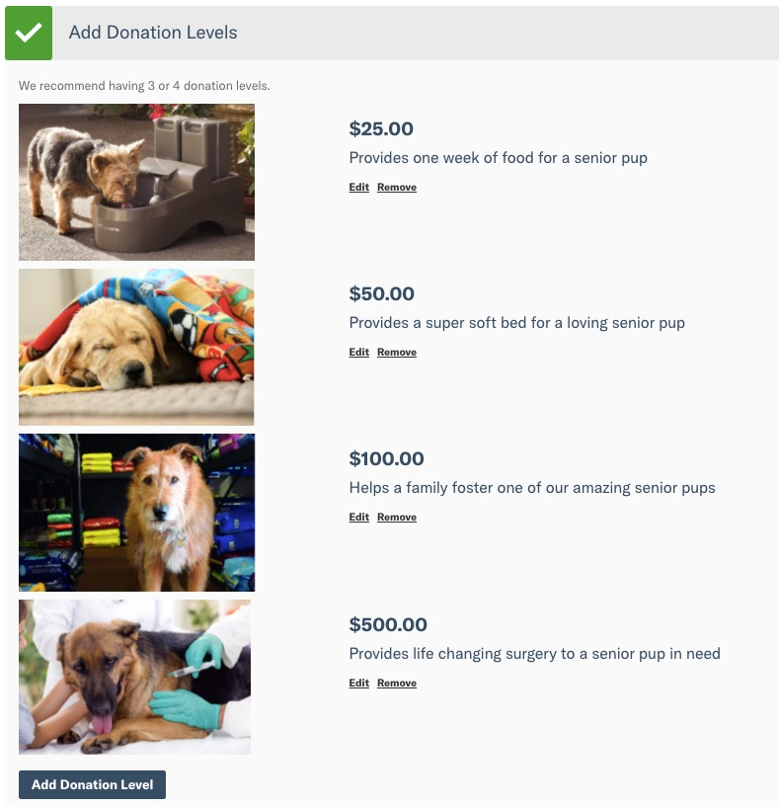
Suggest Donation Levels
Custom amounts
Unique descriptions
Optional photos
Unlimited Levels
Pro Tip: Using custom amounts to represent your organization, like a tangible good or service, further connects the donor to your goal
Notes:
Presenter Notes:
Custom amounts
Unique descriptions
Optional photos
Unlimited Levels
Pro Tip: Using custom amounts to represent your organization, like a tangible good or service, further connects the donor to your goal
Presenter Script:
Next, you’ll have the opportunity to set up suggested donation levels for your profile.
These suggested donation amounts can be tied to a specific program cost or organization expense, and can help donors visualize the impact that their gift will have. And don’t be afraid to get specific with the amounts!
For example, if you are an SPCA and it costs $35.85 to provide vaccines for a litter of kittens - that would make a great donation level. Donors will always have the option to donate a custom amount.

Slide 23
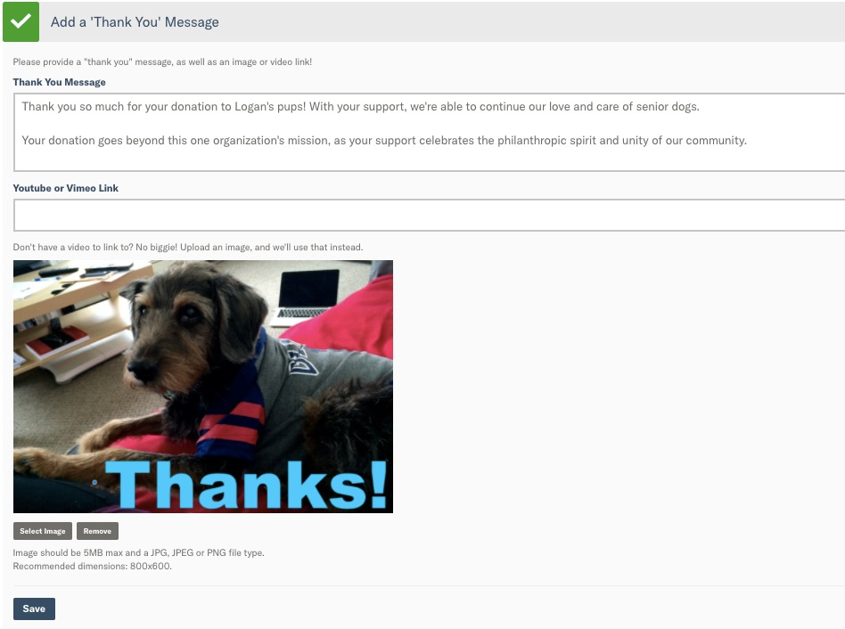
Personalized Gratitude
Add your own message
Include a photo or video for more personal stewardship!
Sent immediately to your donors when they complete their gift
Donors can reply to that email and contact you directly
Notes:
Presenter Notes:
Add your own message
Include a photo or video for more personal stewardship!
Sent immediately to your donors when they complete their gift
Donors can reply to that email and contact you directly
Presenter Script:
[Modify if day is centrally routed.] The next step is to add a thank you message. This is a custom thank you message that will be included on your donors’ tax-deductible receipt and is the first point of contact from your organization after they’ve made their donation.
Ensure that it is filled out with a personalized thank you message that includes an image or video if possible.
Thank you emails will automatically come from your organization’s main contact to provide an extra personal touch to donors.

Slide 24
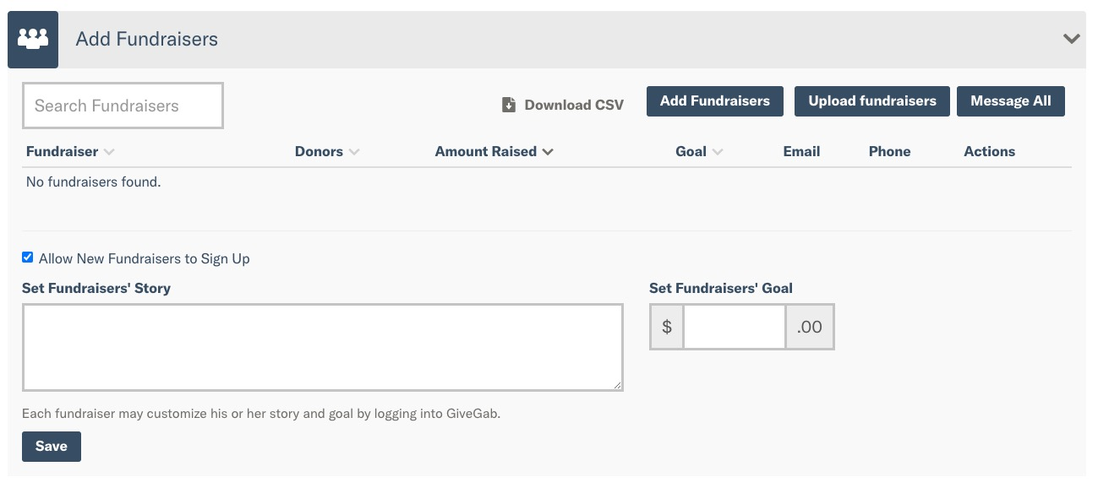
Invite Your Fundraisers
Ask supporters to reach out to their networks on your behalf
Each fundraiser creates their own page to collect donations. Their totals roll up into your totals!
Easily manage their pages
Pro Tip: Watch the Peer-to-Peer Fundraising Training Video
Notes:
Note: Quick live demo show where to find on your dashboard. Example: https://www.givegab.com/nonprofits/peninsula-community-foundation/giving_days/peninsulava2022
Presenter Notes:
Ask supporters to reach out to their networks on your behalf
Each fundraiser creates their own page to collect donations. Their totals roll up into your totals!
Easily manage their pages
Pro Tip: Watch the Peer-to-Peer Fundraising Training Video
Presenter Script:
The final checkbox on your Giving Day Dashboard is to Invite P2P Fundraisers. Adding fundraisers means that you are asking your existing supporters to reach out to their networks on your behalf to raise awareness and funds for your organization.
While this step is optional, organizations that use P2P fundraisers for their Giving Day strategy raise more funds on average than those who don’t.
Each P2P fundraiser creates their very own page to collect donations, and their totals roll right up into your totals.
While each P2P fundraiser is encouraged to set up their own profile, we understand that certain fundraisers may not have the time or know-how to do so. In this case, we make it easy for you to update their profiles for them. As an admin, you’ll be able to upload images, set a goal, and set a story for why that fundraiser is participating in [DoG].
We have tons of great information available on [DoG URL] to help your fundraisers run a fantastic P2P campaign. Be sure to check out the P2P Fundraising Training Video and share it with your fundraisers.

Slide 25
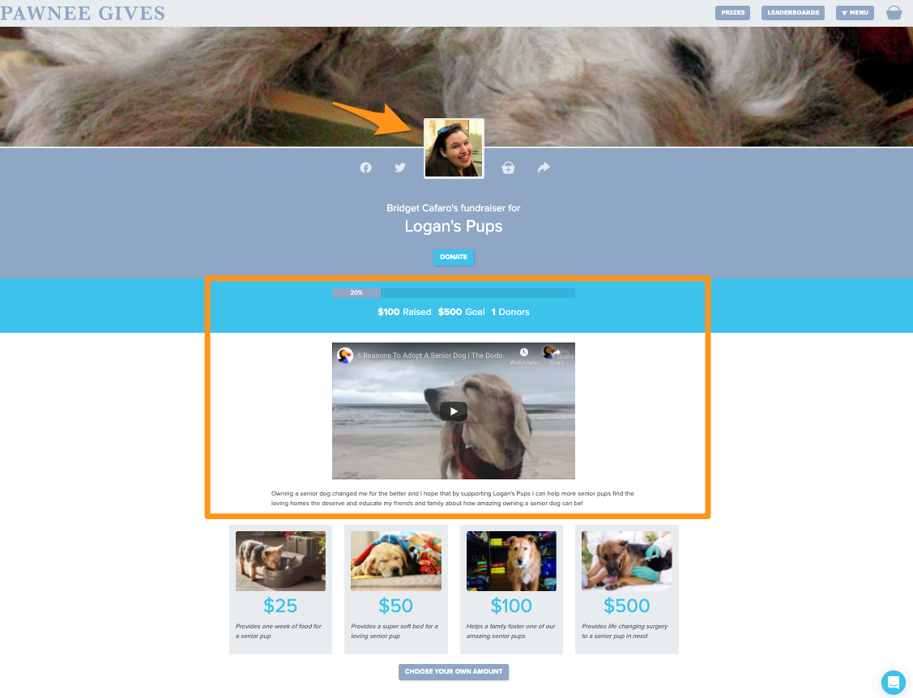
Notes:
Presenter Notes:
Here’s a quick example of a completed P2P fundraiser page.
Note the profile image, set goal, and custom video and blurb
All other branding is pulled in from your organization’s profile
Presenter Script:
Here is an example of a completed P2P Fundraising page. As you can see, the P2P Fundraiser has uploaded a profile image to help personalize their profile. They’ve also set a goal, and their progress towards that goal will be tracked once donations are open.
Additionally, they’ve entered a custom video explaining why they’re passionate about fundraising for this cause, as well as a little blurb.
Other than those personalized elements, the rest of the P2P Fundraising page is completely branded towards your organization and [DoG].

Slide 26
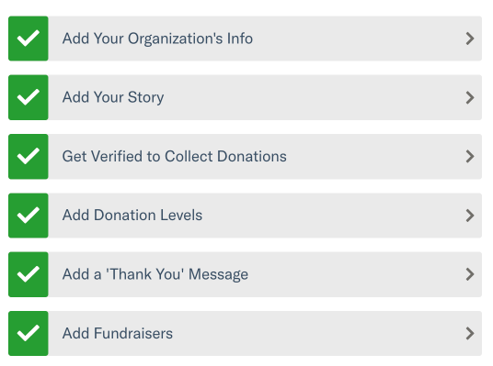
Is Your Profile Complete?
Have you:
Added your logo and a cover photo?
Shared an authentic story?
Set goals?
Included clear calls to action?
Featured visual content?
Highlighted donation levels?
Invited your fundraisers?
Notes:
Presenter Script:
Within your organization dashboard, you will see the tabs you see in this screenshot. Once completed, a green checkmark will appear next to them.
So, is your profile complete? Have you:
Added your organization’s logo and a cover photo?
Have you shared an authentic story? In this tab, you can set goals for how much you’d like to raise and include clear calls to action. You can also feature other visual content, like additional images or videos.
Have you highlighted donation levels? In this tab, you can set various donation levels and describe what each level of donation would allow your organization to accomplish.
And finally, have you invited your fundraisers? In this tab, you can invite individuals to fundraise on your organization’s behalf. Organizations who utilize this feature raise 2.9X more on average than organizations that do not. I highly recommend looking at the Fundraiser Guide available in the dropdown menu on the [DoG] website for more information on how you can leverage the P2P Fundraisers tool.

Slide 27
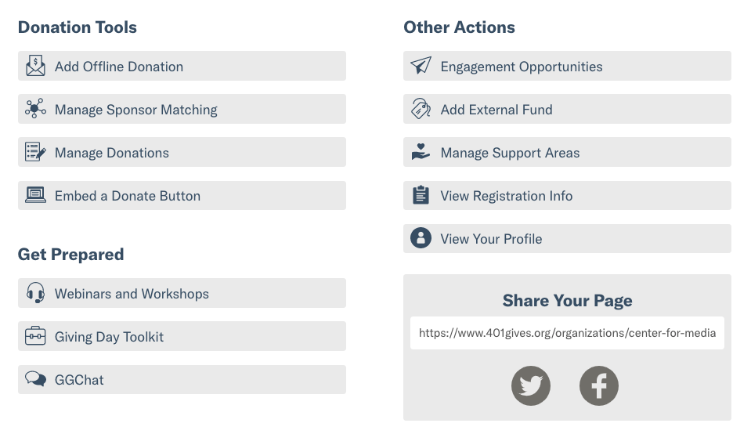
Key Dashboard Tools
Notes:
Presenter Notes:
Highlight additional actions that admins have available to them right within their Giving Day Dashboard
Especially call attention to offline donations, matching, and support areas
Presenter Script:
In addition to those [6] key steps to setting up your Giving Day profile, there are tons of additional tools to help you manage your Giving Day right from your dashboard.
For example, you’ll be able to add offline donations to your totals, manage sponsor matching, view a Giving Day scoped donation report and more.
From your dashboard we also provide quick access links to webinars and other training materials, our Giving Day toolkit, and Help Center.
Lastly, you’ll have the opportunity to provide external fund numbers to help code donations that come in through Giving Day, as well as add support areas, and view your profile as it’s being worked on.

Slide 28
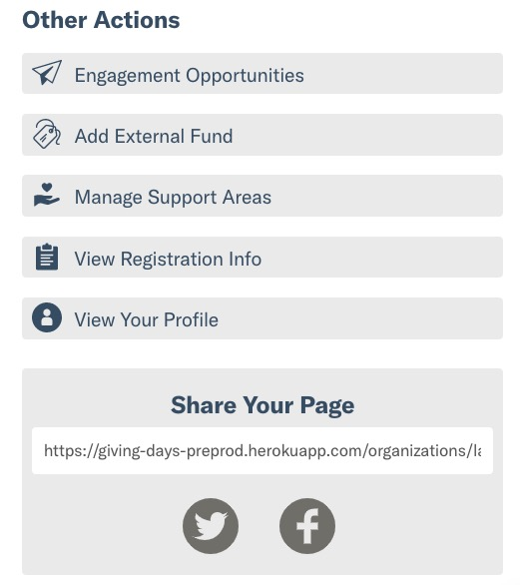
Share Your Profile
Preview your profile along the way
Share this link with your supporters
Post directly to Twitter and Facebook from your dashboard
Notes:
Presenter Notes:
Preview your profile along the way
Share this link with your supporters
Post directly to Twitter and Facebook from your dashboard
Presenter Script:
As you work through setting your profile up, you can easily view it by selecting the “View Your Profile” option beneath “Other Actions.”
Once your profile is fully completed and ready to share out to the world, you can use the link within the “Share your Page” box to share your Giving Day profile anywhere. You can also use the quick share buttons to easily share to Twitter and Facebook.

Slide 29
How Will You Get Your Donations?
The Greater Green Bay Community Foundation will disperse your funds after donations close on Feb 22 at noon CT
Reference your Financials report to reconcile deposits!

Slide 30
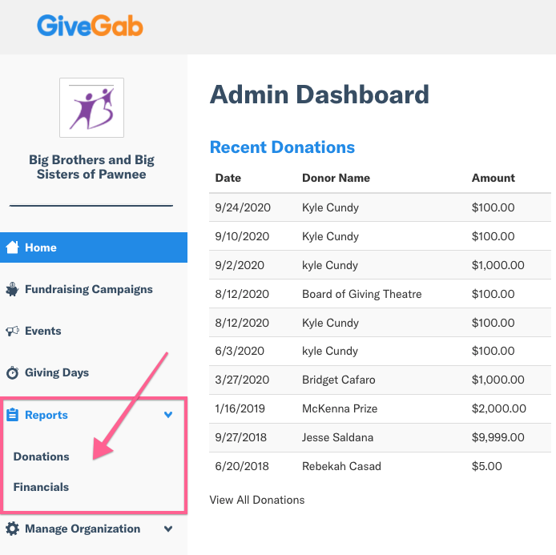
Finding Your Donor Data
Notes:
Presenter Script:
This is what your home page looks like on the Admin Dashboard for your org. You’ll see some recent donations, but this isn’t your full report. Click on “Reports” while in your Admin Dashboard to be taken to your organization’s donation records and information. From there, you will see two items appear in the dropdown [IF NOT CR DOG] - “Donations” and “Financials”. The Donations tab is what you’ll want to click to find your full donor report, which we’ll show in just a moment. The Financials tab is another helpful resource for your team handling all of the reconciliation of donations. Opening that tab will show a history of deposits to your bank account, and which donations each were comprised of. You can think of it as more of an accounting view of what your organization received. Now, to look at your donor data, you’ll click on “Donations”.

Slide 31
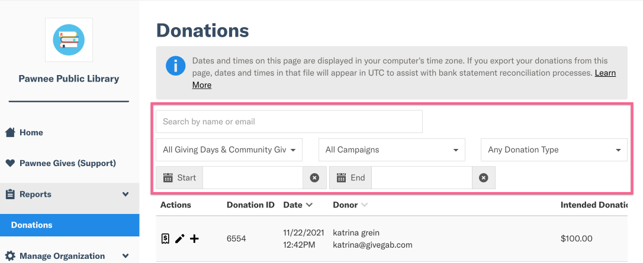
Filtering Your Data
Notes:
Presenter Script:
While on your donations table, you can view the various filter options available. For example, dates, name or email search, which Giving Day. These filters will narrow down what you see in your table in real time, as well as what appears in your exported file when you opt to download that (next slide!)

Slide 32
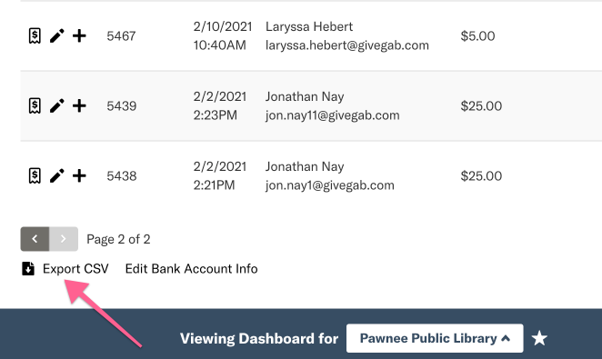
Exporting Your Donor Data
Notes:
Presenter Script:
Once you have filtered your donations, you can now export them as a CSV to your email inbox. Scroll to the bottom of the page and click "Export CSV", which will send the file to your email. The email will come from notifications@givegab.com and will contain a link to the file.

Slide 33
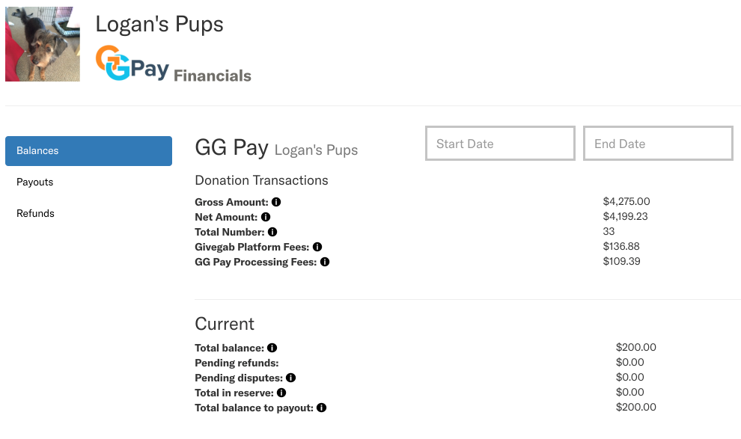
Reconciliation
The Financials reporting dashboard allows you to view your balance and donations from an accounting perspective
Match each online gift to a deposit
Notes:
Presenter Notes:
Understand your balance and donations from an accounting perspective
Easily match each online gift to a deposit
Presenter Script:
The Financials tab is another helpful resource for your team handling the reconciliation of donations. The financial reporting dashboard allows you to view your balances at a glance, group donations by payout date, and view any refunds associated with your account to provide helpful insights to your accounting teams.

Slide 34
Peer to Peer
Notes:
Presenter Notes:
Next, I wanted to cover some information about an extremely useful feature, Peer to Peer Fundraising

Slide 35
What is Peer to Peer?
Expand your network and foster connections through existing ones
Trusting existing supporters to expand your reach
Each fundraiser brings in about 4 donors on average for Giving Days
Notes:
Presenter Script:
So what is peer to peer?
It's a way to utilize and steward your existing supporters to expand your reach and bring in new donors!
Peer to peer fundraisers can be volunteers at your organization, donors, board members, or even family members that just want to help!
We have found that, on average for giving days, fundraisers bring in about 4 new donors to an organization

Slide 36
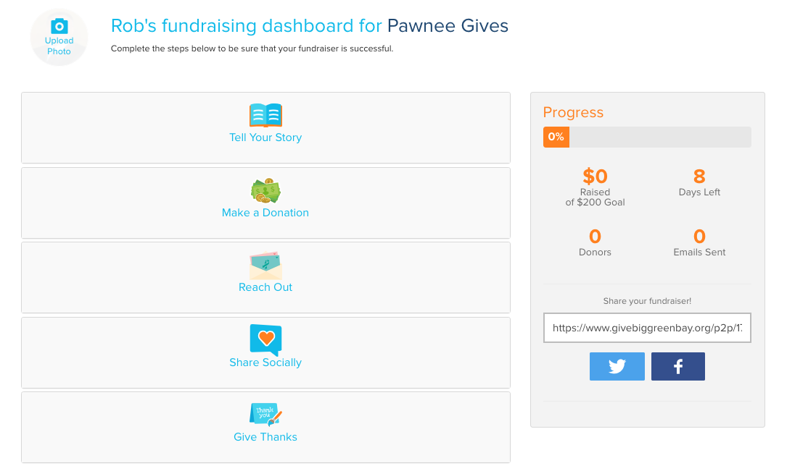
P2P Dashboard
Notes:
Presenter Script:
When p2p sign up to help your organization, they get to create their own dashboard.
They can explain why your cause is important to them, write a thank you message to any incoming donors, and easily share their profile out to supporters via email or social media.
They can also set a goal and track their progress!

Slide 37
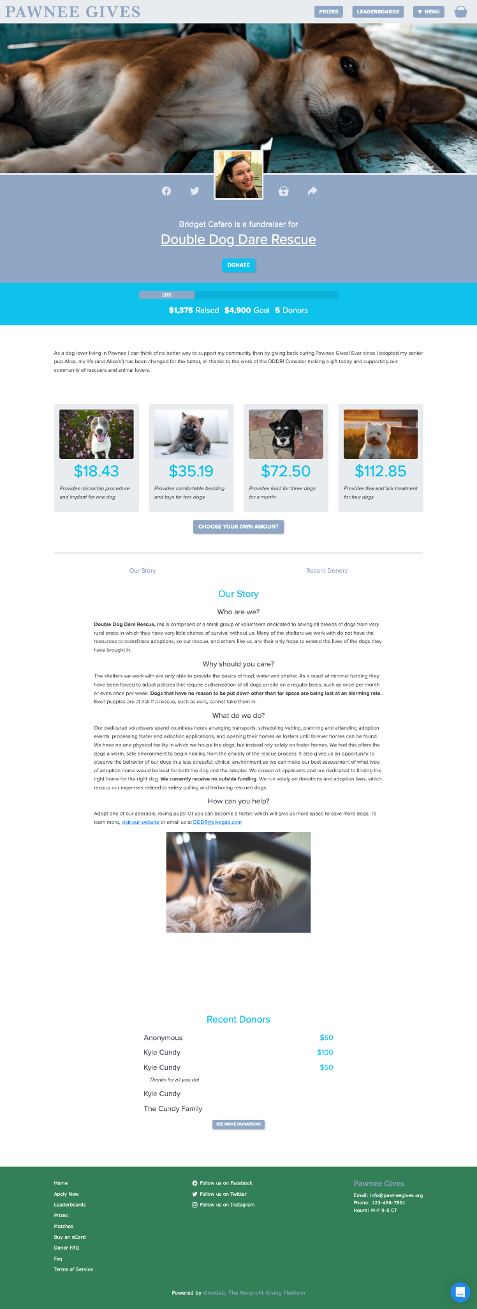
P2P Example
Notes:
Presenter Script:
Here is a great example of a P2P profile for another Giving Day!
Its engaging, includes a story and images and has even set donation levels to engage views and potential donors!

Slide 38
What’s Next?
Notes:
Presenter Notes:
So, what’s next?

Slide 39
Your Nonprofit Toolkit
The Nonprofit Toolkit has valuable resources for all your GBGB needs.
Templates
Downloadable graphics
Resources for board members, volunteers, staff and fundraisers
Training videos for fundraising strategies!
Notes:
Presenter Notes:
The Nonprofit Toolkit has valuable resources for all your [DoG] needs.
Templates
Downloadable graphics
Resources for board members, volunteers, staff and fundraisers
Training videos for fundraising strategies!
Presenter Script:
Before we talk about next steps, I wanted to take some time to highlight the Nonprofit Toolkit.
The nonprofit toolkit is a valuable resources for all your Giving Day needs. It includes communication templates, downloadable graphics, resources for board members, volunteers, and fundraisers, as well as tons of on-demand training videos to help you prepare for [DoG].
We encourage you to leverage these resources as you prepare for Giving Day, and feel encouraged to rely on them for your year round fundraising efforts as well!

Slide 40
Your Success Checklist
Ready for Donations?
The Perfect Profile
Gamify with Matches & Challenges
Engage Ambassadors
Prepare Communications
Notes:
Presenter Script:
Here is your ultimate success checklist.

Slide 41
Your Next Steps
What to work on over the next few weeks:
Follow Give Big Green Bay on Social Media and use #givebiggb Hashtag
Watch your inbox for important emails
Meet internally to discuss goals
Sign up for upcoming webinars
Explore the toolkit
Notes:
Presenter Notes:
What to work on over the next [X months/weeks]:
Follow [DoG] on Social Media and use #[DoG] Hashtag
Watch your inbox for important emails
Meet internally to discuss goals
Sign up for upcoming webinars
Explore the toolkit
Presenter Script:
Over the next few weeks, take some time to do the following -
Follow [DoG] on social media and remember to use the hashtag #[hashtag] when posting about [DoG]
Watch your inbox for important emails from both GiveGab/Bonterra and [Partner Organization] - this will be our main method of communication with you as you prepare for Giving Day, and we don’t want you to miss out on any important information!
If you have others in your organization that you’ll be working with on your Giving Day efforts, consider meeting internally to discuss what goals you have for [DoG]
Mark your calendar for the upcoming webinars and make sure to register
And lastly, explore the toolkit to see what resources your organization can leverage this year!

Slide 42
Questions?
Feb 19, 2025
Notes:
Presenter Notes:
Thank organizations for attending
Transition to answering questions that came in via the Q&A box
If possible, also monitor the chat to see if any were accidentally sent through there
Presenter Script:
Thank you all so much for joining us today for Getting Ready for [DoG]! We went over a TON of information in this presentation, and as a reminder, we will have the slides and recording available on the trainings page of [DoG URL] shortly. At this time, we’ll address any questions that you might have. If you haven’t submitted your question yet, make sure to find your Q&A box and submit them now.

